Slide 1
Developing a Web Site
Creating a Web Site for Amateur Photographers

Slide 2
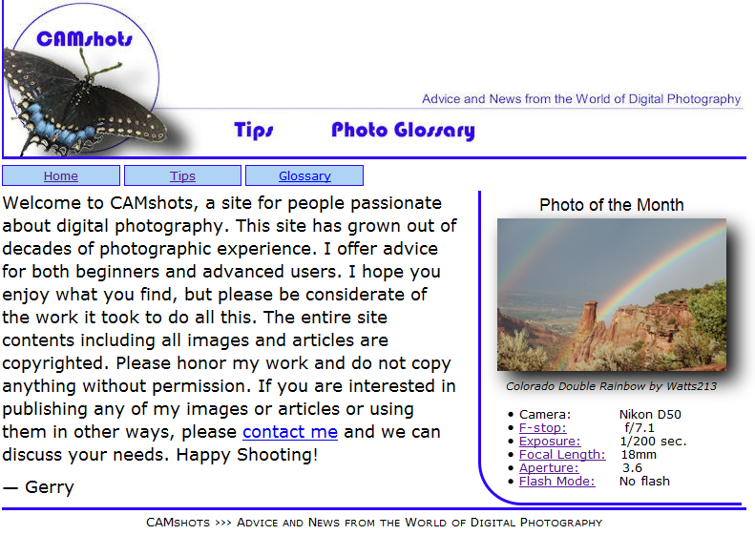
Case: CAMshots
Gerry Hayward is an amateur photographer and digital camera enthusiast. He’s creating a Web site named CAMshots. He has asked for your help in designing his site and creating links between the pages.

Slide 3
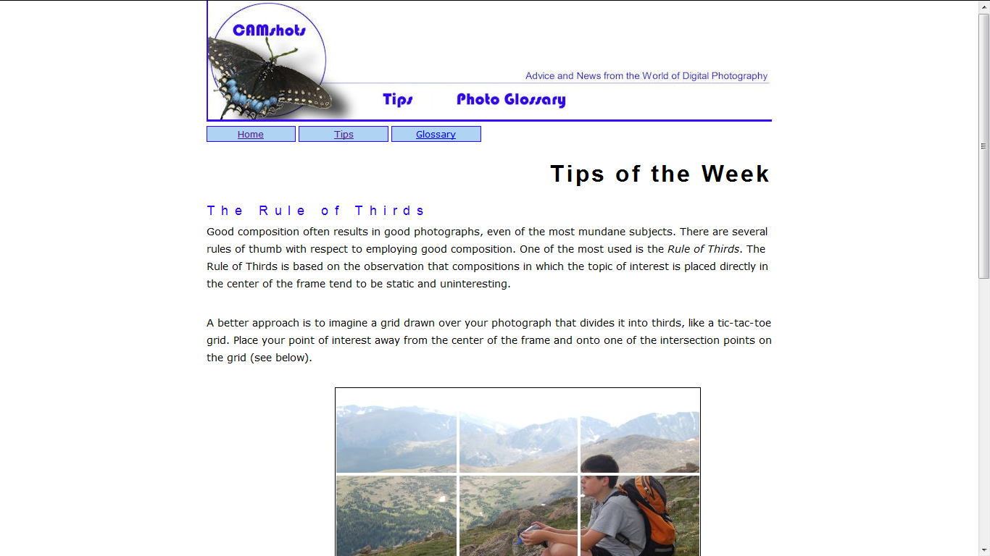
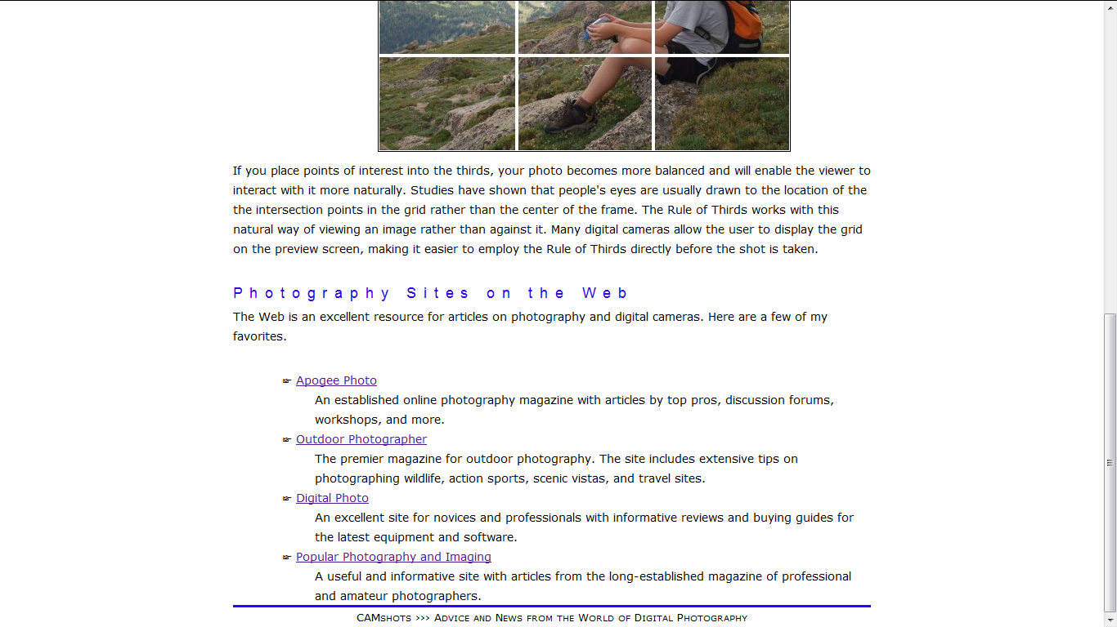

Slide 4
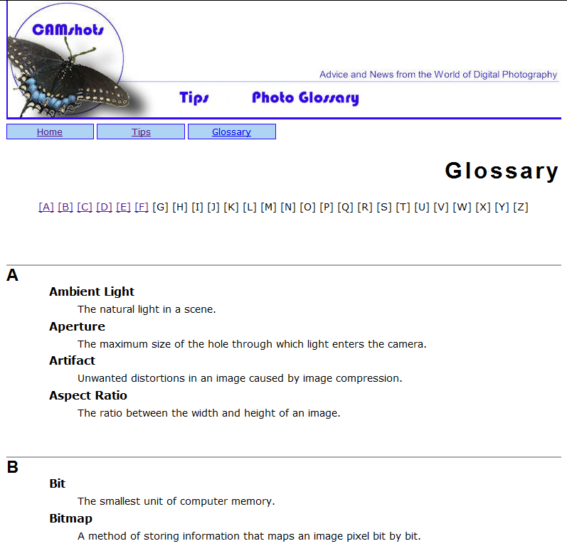

Slide 5
View Gerry’s Web pages
Start your text editor, and then open the hometxt.htm, tipstxt.htm, and glosstxt.htm files, located in the tutorial.02\tutorial folder included with your Data Files.
Within each file, go to the comment section at the top of the file and add your name and the date in the space provided.
Save the files as home.htm, tips.htm, and gloss.htm, respectively, in the tutorial.02\tutorial folder.
Take some time to review the HTML code within each document so that you understand the structure and content of the files.
Start your Web browser and open the home.htm, tips.htm, and gloss.htm files. The figure below shows the current layout and appearance of Gerry’s three Web pages.

Slide 6
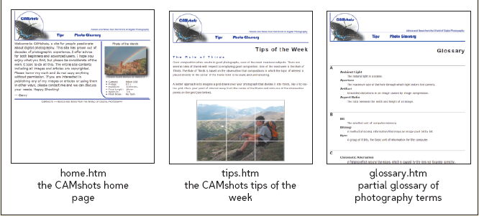
View Gerry’s Web pages

Slide 7
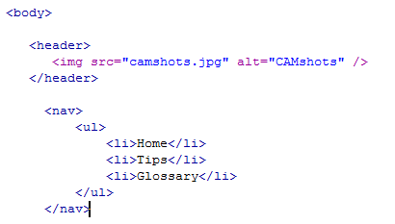
Create the navigation list
Return to the home.htm file in your text editor
At the top of the file directly below the header element, insert the following code as shown below:
<nav>
<ul>
<li>Home</li>
<li>Tips</li>
<li>Glossary</li>
</ul>
</nav>
Go to the gloss.htm, tips.htm in your text editor and add a navigation list to that file.
Refresh pages on your web browser

Slide 8
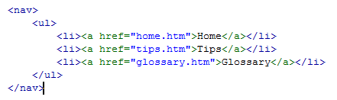
Create a hypertext link to a document
Return to the home.htm file in your text editor and go to the navigation list at the top of the page.
Mark the text Home as a hypertext link using a set of <a> tags as follows: <a href=”home.htm”>Home</a>
Mark the text Tips as a hypertext link using the following code: <a href=”tips.htm”>Tips</a>
Mark the text Glossary as a hypertext link as follows: <a href=”gloss.htm”>Glossary</a>
Go to the tips.htm, gloss.htm in your text editor and then change the text of the navigation list to hypertext links

Slide 9
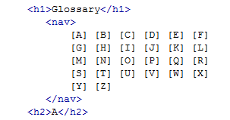
Linking to Locations within a Document Create the navigation list
Return to the gloss.htm file in your text editor
Scroll down to the section element. Directly below the h1 Glossary heading, insert the following navigation list
<nav>
[A] [B] [C] [D] [E] [F] [G] [H] [I] [J] [K] [L] [M] [N] [O] [P] [Q] [R] [S] [T] [U] [V] [W] [X] [Y] [Z]
</nav>

Slide 10
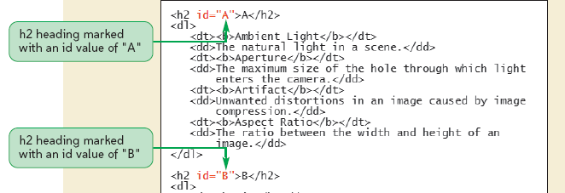
Linking to Locations within a Document Marking Locations with the id Attribute
Scroll down the file and locate the h2 heading for the letter A. Within the opening <h2> tag, insert the following attribute: id=”A”
Locate the h2 heading for the letter B and insert the following attribute in the opening <h2> tag: id=”B”
Continue going down the file, adding id attributes to the opening <h2> heading tags for C, D, E, and F corresponding to the letters of those headings.

Slide 11
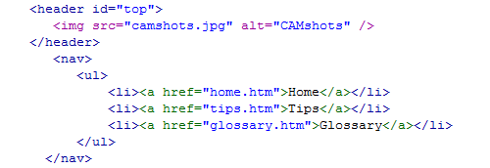
Linking to Locations within a Document Mark the top of the page
Scroll up the gloss.htm file in your text editor and locate the header element directly below the opening <body> tag.
Insert the following attribute within the opening <header> tag id=”top”

Slide 12
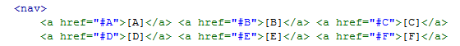
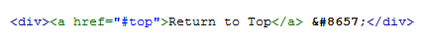
Linking to Locations within a Document Link to an id, change the list of letters to text links
Locate the letter A in the list of letters at the top of the gloss.htm file.
After the [ character, insert the following opening tag: <a href=”#A”>
Between the letter A and the ] character, insert the closing </a> tag.
Mark the letters B through F in the list as hypertext links pointing to the appropriate h2 headings in the document.
Scroll to the bottom of the file and locate the text Return to Top. Mark the text as a hyperlink, pointing to the element with an id value of top.

Slide 13
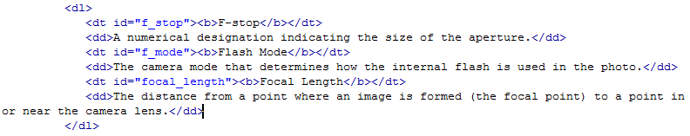
Creating Links to ids in Other Documents Mark the glossary entries
Return to the gloss.htm file in your text editor
Scroll through the file and locate the Aperture definition term
Within the opening <dt> tag, insert the following attribute: id=”aperture”
Scroll down the file and locate the Exposure definition term, within the opening <dt> tag, insert the following attribute: id=”exposure”
Go to the F section of the glossary and mark the terms with the following ids
F-stop with the id f-stop
Flash Mode with the id flash_mode
Focal Length with the id focal_length

Slide 14
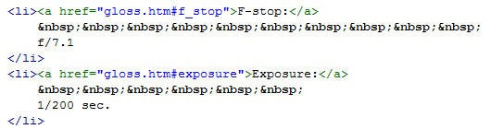
Creating Links to ids in Other Documents Create links to the glossary entries
Open the home.htm file in your text editor.
Scroll down the file and locate the F-stop term in the unordered list.
Mark F-stop as a hypertext link using the following code:
<a href=”gloss.htm#f-stop”>F-stop</a>
Mark Exposure as a hypertext link using the following code:
<a href=”gloss.htm#exposure”>Exposure</a>
Mark the remaining three entries in the unordered list as hypertext pointing to their corresponding entries on the Glossary page.

Slide 15
Working with Linked Images and Image Maps Link the Photo of the Month image
Return to the home.htm file in your text editor.
Scroll down to the img element for the Photo of the Month and then enclose the inline image within a set of <a> tags as follows:
<a href=”rainbow_lg.png”>
<img src=”rainbow.png” alt=”Photo” />
</a>
Refresh home page on your web browser

Slide 16
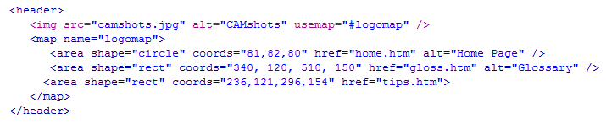
Working with Linked Images and Image Maps Create an image map
Return to the home.htm file in your text editor
Directly below the <img> tag for the CAMshots header image, insert the following map element: <map name=”logomap”></map>
Within the map element, insert a circular hotspot that points to the home.htm file using the following area element:
<area shape=”circle” coords=”82, 82, 80” href=”home.htm” alt=”Home Page” />
Directly below the <area> tag for the circular hotspot, insert the following two rectangular hotspots pointing to the tips.htm and gloss.htm files:
<area shape=”rect” coords=”235, 120, 310, 150” href=”tips.htm” alt=”Tips” />
<area shape=”rect” coords=”340, 120, 510, 150” href=”gloss.htm” alt=”Glossary” />

Slide 17
Working with Linked Images and Image Maps Apply the logomap image map
Add the following attribute to the <img> tag for the CAMshots logo: usemap=”#logomap”
Go to page tips.htm, gloss.htm, and replace the code in the header by the code in page home.htm

Slide 18
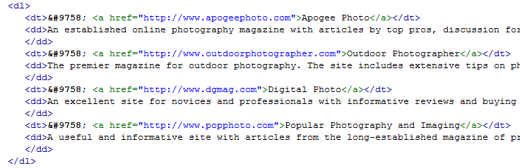
Create links to sites on the Web
Return to the tips.htm file in your text editor.
Scroll to the bottom of the file and locate the definition list containing the list of Web sites.
Mark the entry for Apogee Photo as a hypertext link using the following code: <a href=”http://www.apogeephoto.com”>Apogee Photo</a>
Mark the remaining three entries in the list as hypertext links pointing to each company’s Web site.

Slide 19
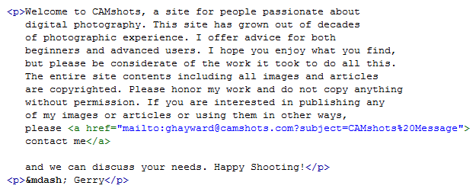
Link to an e-mail address on Gerry’s home page
Return to the home.htm file in your text editor.
Go to the first paragraph and locate the text contact me.
Mark contact me as a hypertext link using the following code
<a href=”mailto:ghayward@camshots.com?subject=CAMshots%20Message”> contact me </a>

Slide 20
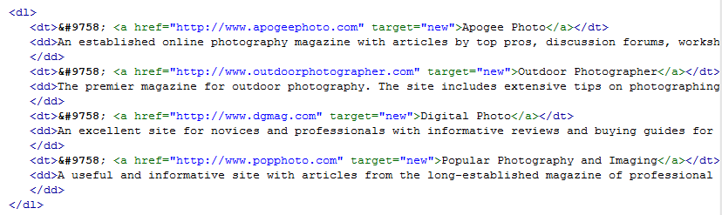
Specify a link target
Return to the tips.htm file in your text editor.
Scroll to the bottom of the file and locate the four links to the external Web sites.
Within each of the opening <a> tags, insert the following attribute:
target=”new”

Slide 21
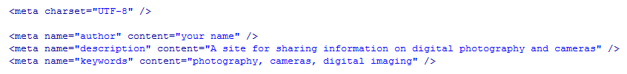
Working with Metadata
To be noticed on the Web, a site needs to include information about itself for search engines to read and add to their search indices. Information about a site is called metadata.
Return to the home.htm file in your text editor.
Directly below the meta element that defines the document’s character set, insert the following meta elements:
<meta name=”author” content=”your name” />
<meta name=”description” content=”A site for sharing information on digital photography and cameras” />
<meta name=”keywords” content=”photography, cameras, digital imaging” />

